Slide 1
Chapter 11
Input-Output Systems
1

Slide 2
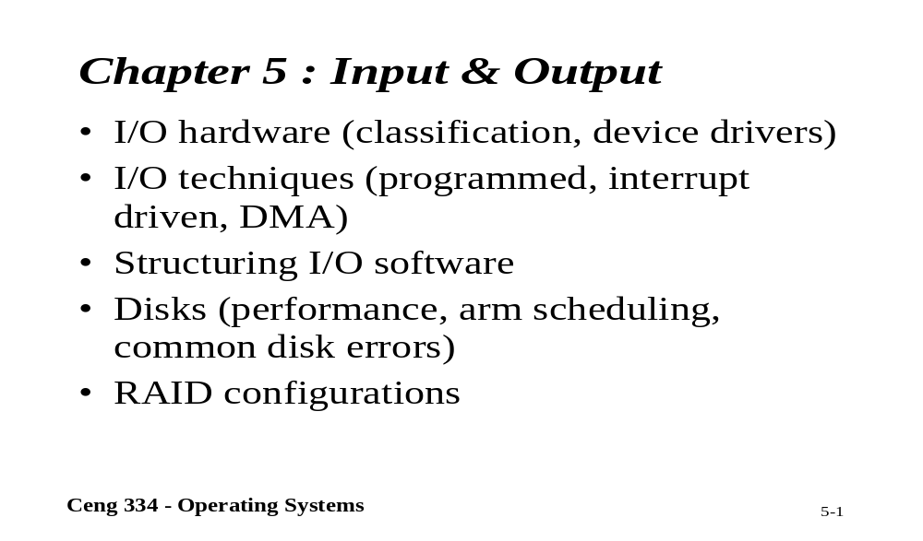
Chapter 5.1: Input and Output

Slide 3
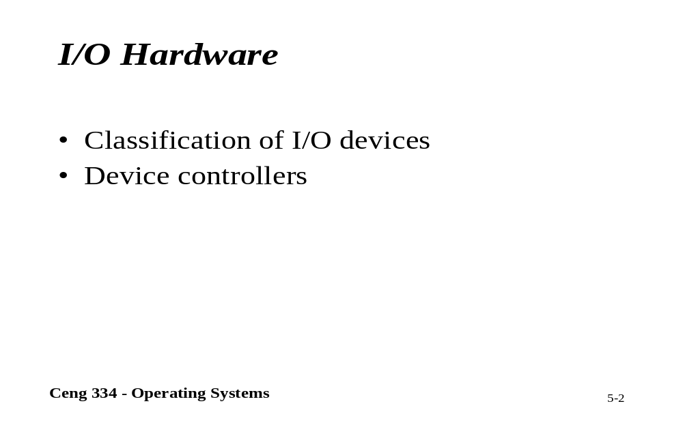
I/O Hardware

Slide 4
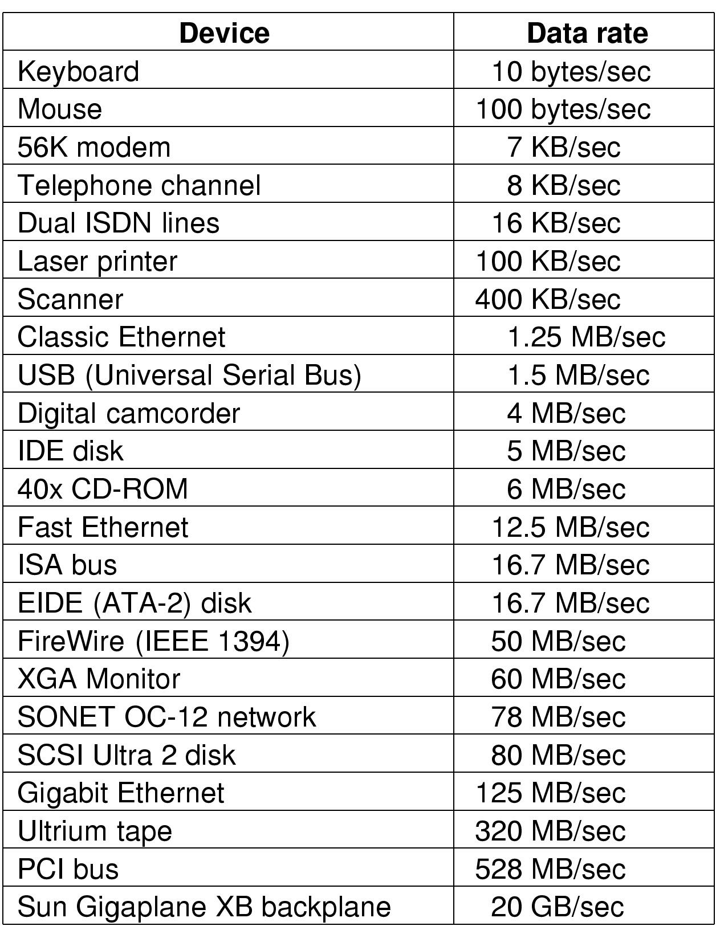
Principles of I/O Hardware
Some typical device, network, and data base rates

Slide 5
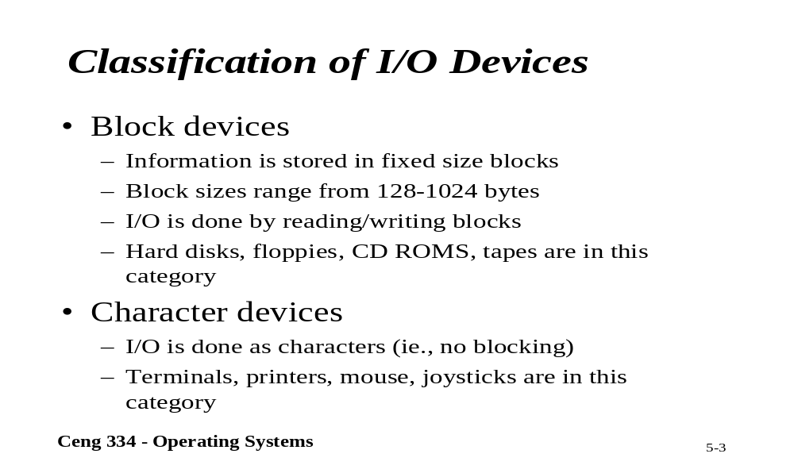
Classification of I/O Devices

Slide 6
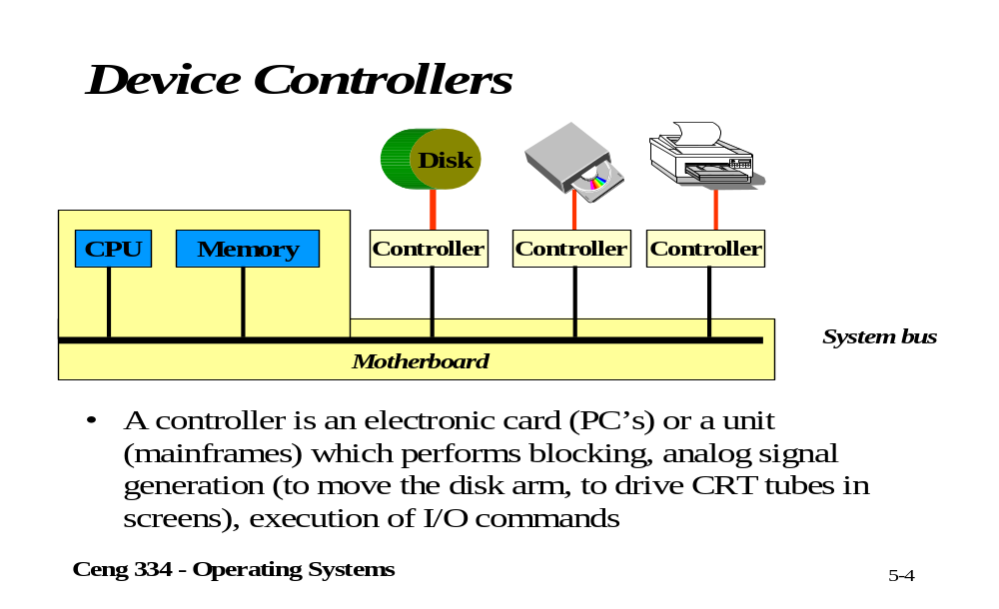
Device Controllers

Slide 7
Device Controllers
I/O devices have components:
  mechanical component
  electronic component
The electronic component is the device controller
  may be able to handle multiple devices
Controller's tasks
  convert serial bit stream to block of bytes
  perform error correction as necessary
  make available to main memory

Slide 8
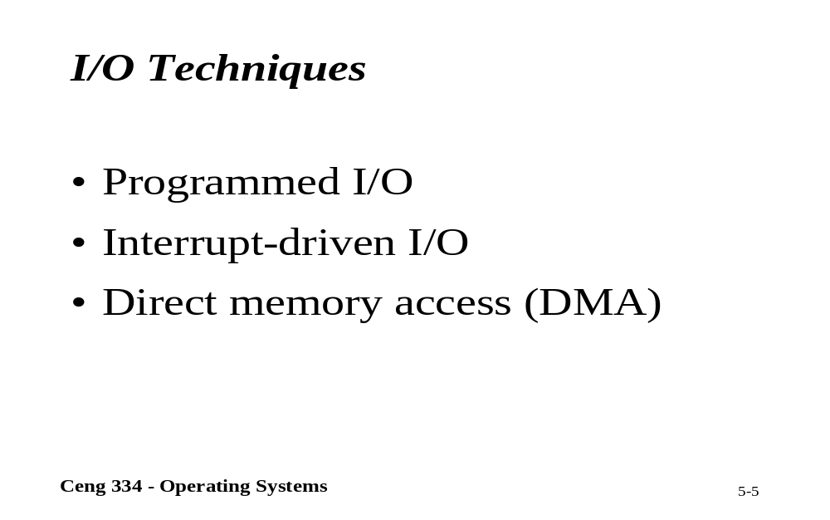
I/O Techniques

Slide 9
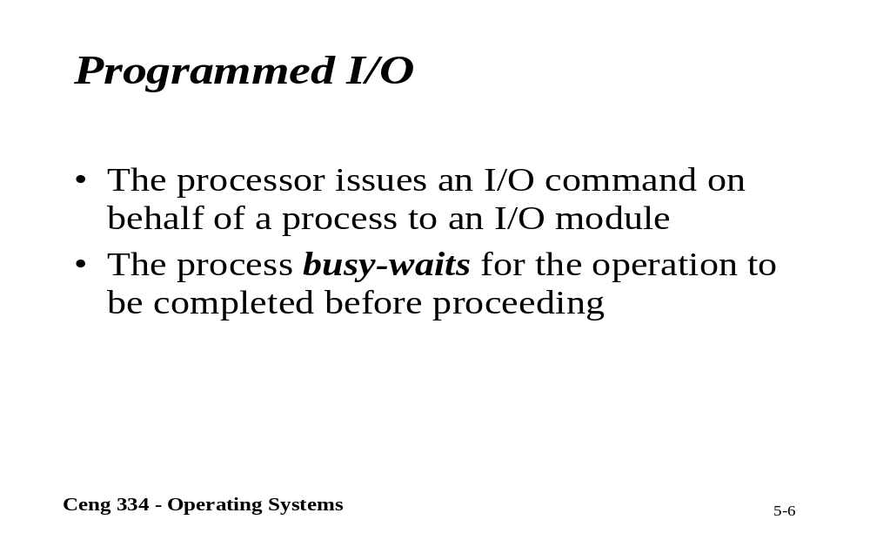
Programmed I/O

Slide 10
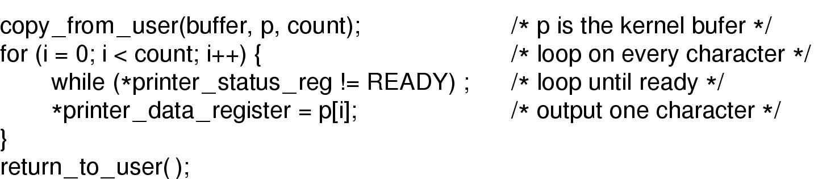
Programmed I/O (2)
Writing a string to the printer using programmed I/O

Slide 11
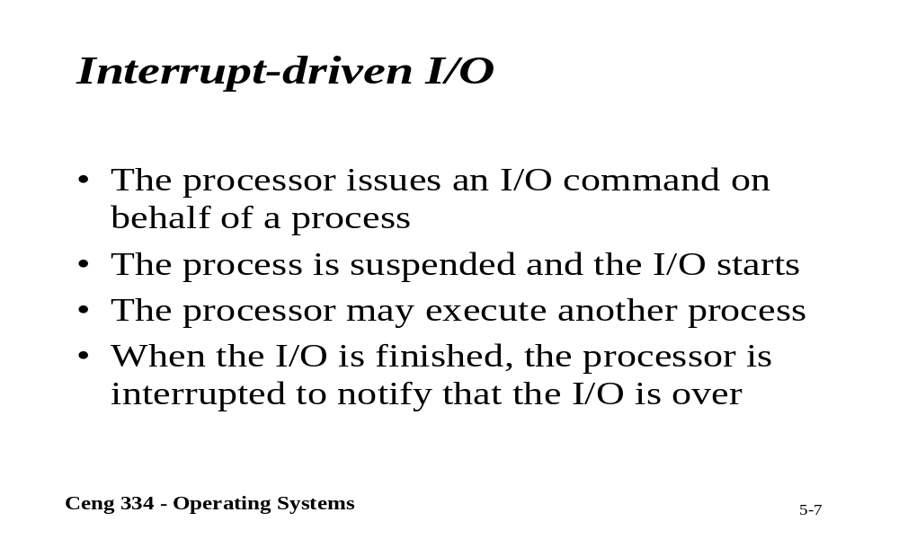
Interrupt-driven I/O

Slide 12

Interrupts Revisited
How interrupts happens. Connections between devices and interrupt controller actually use interrupt lines on the bus rather than dedicated wires

Slide 13
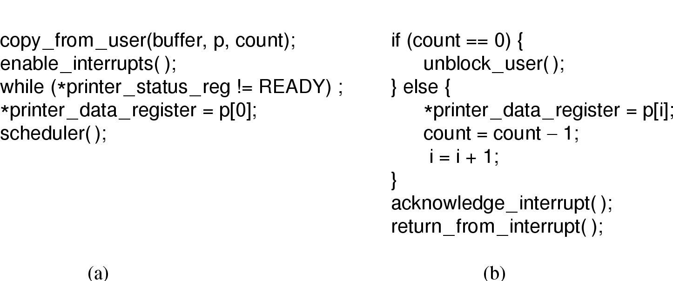
Interrupt-Driven I/O
Writing a string to the printer using interrupt-driven I/O
  Code executed when print system call is made
  Interrupt service procedure

Slide 14
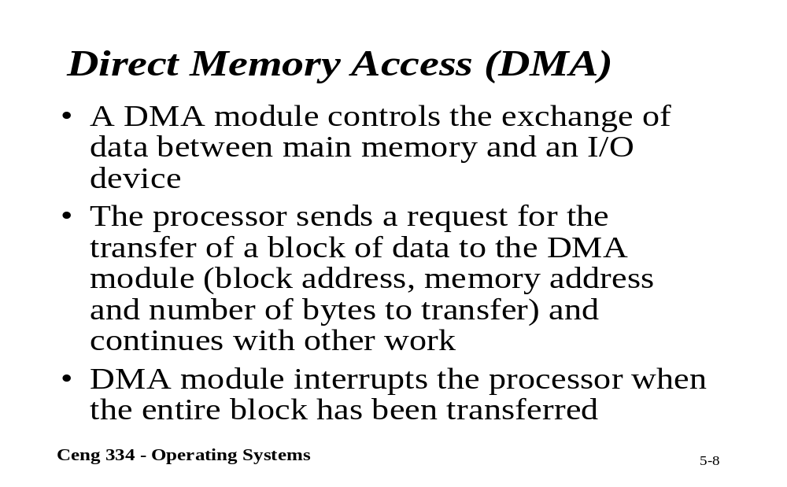
DMA

Slide 15
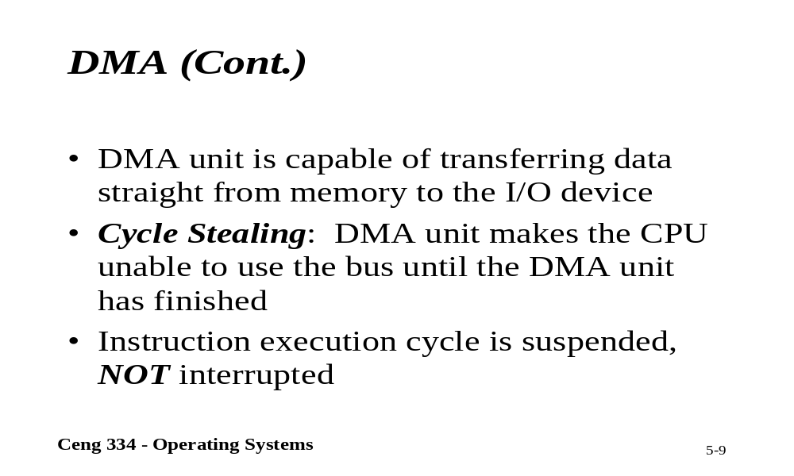
DMA

Slide 16

Direct Memory Access (DMA)
Operation of a DMA transfer

Slide 17
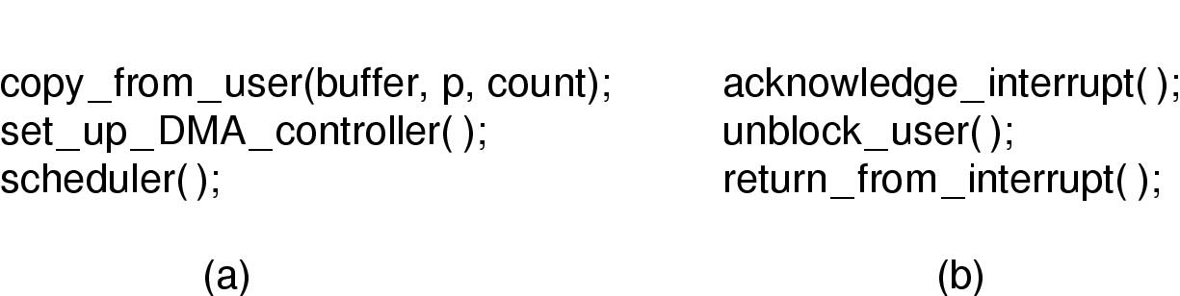
I/O Using DMA
Printing a string using DMA
  code executed when the print system call is made
  interrupt service procedure

Slide 18
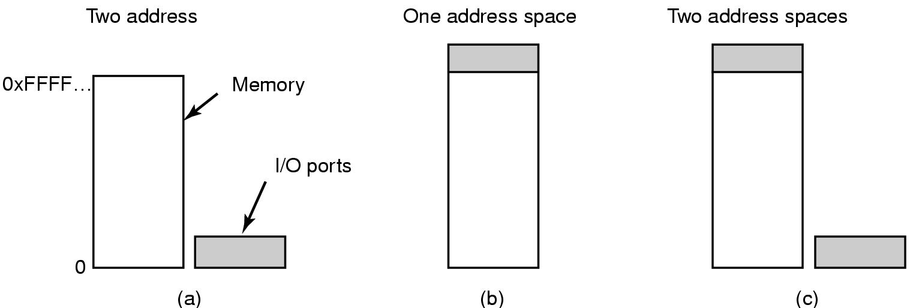
Memory-Mapped I/O (1)
Separate I/O and memory space
Memory-mapped I/O
Hybrid

Slide 19
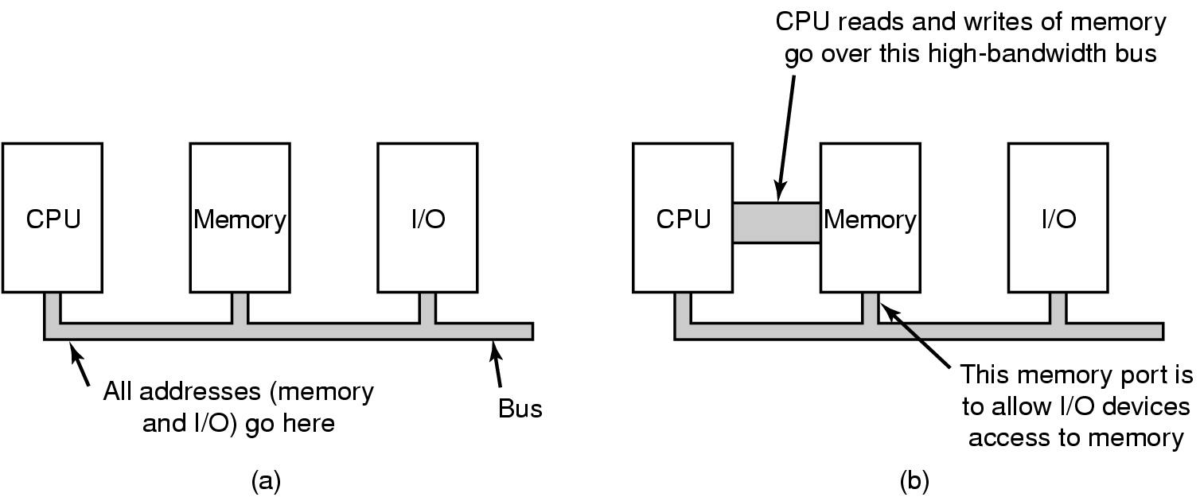
Memory-Mapped I/O (2)
(a) A single-bus architecture
(b) A dual-bus memory architecture

Slide 20
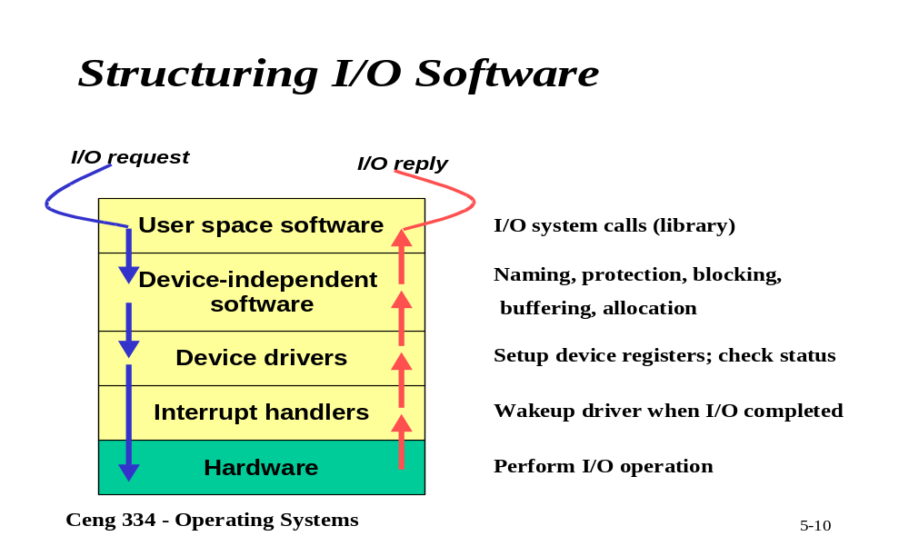
Structuring I/O Software

Slide 21
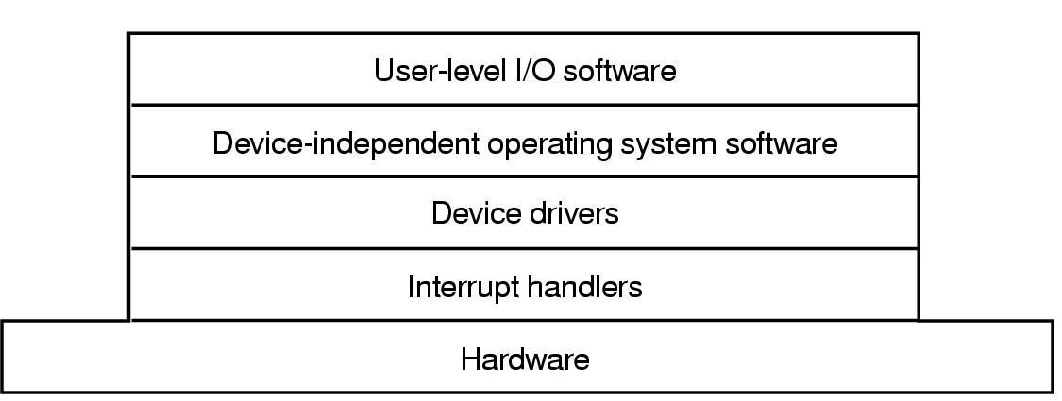
I/O Software Layers
Layers of the I/O Software System

Slide 22
Principles of I/O Software
Goals of I/O Software (1)
Device independence
  programs can access any I/O device
  without specifying device in advance
    (floppy, hard drive, or CD-ROM)
Uniform naming
  name of a file or device a string or an integer
  not depending on which machine
Error handling
  handle as close to the hardware as possible

Slide 23
Goals of I/O Software (2)
Synchronous vs. asynchronous transfers
  blocked transfers vs. interrupt-driven
Buffering
  data coming off a device cannot be stored in final destination
Sharable vs. dedicated devices
  disks are sharable
  tape drives would not be

Slide 24
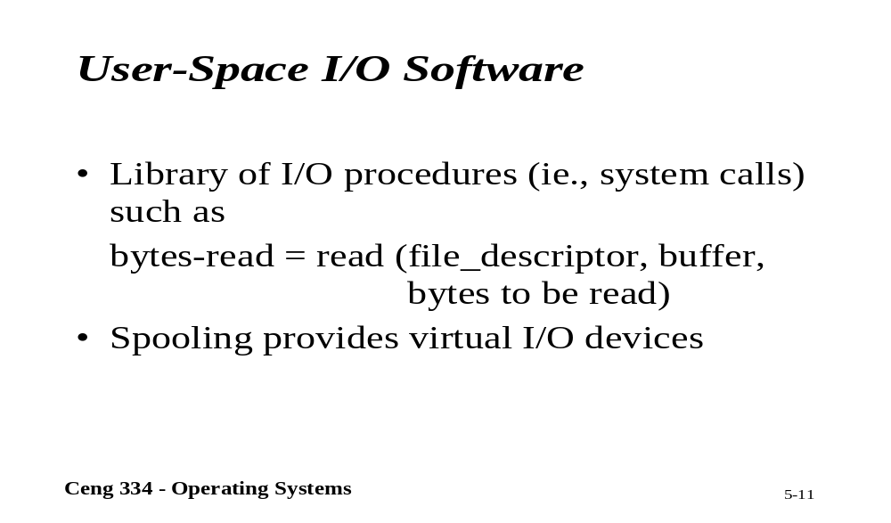
User-sapece; I/O Software

Slide 25
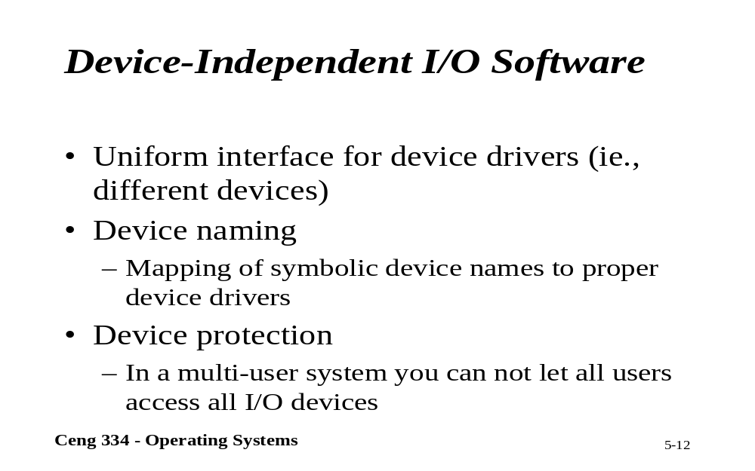
Device-Independents I/O Software

Slide 26
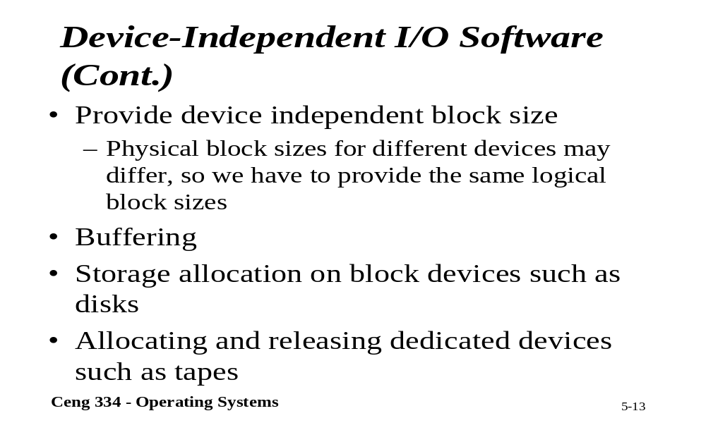
Device-Independents I/O Software

Slide 27
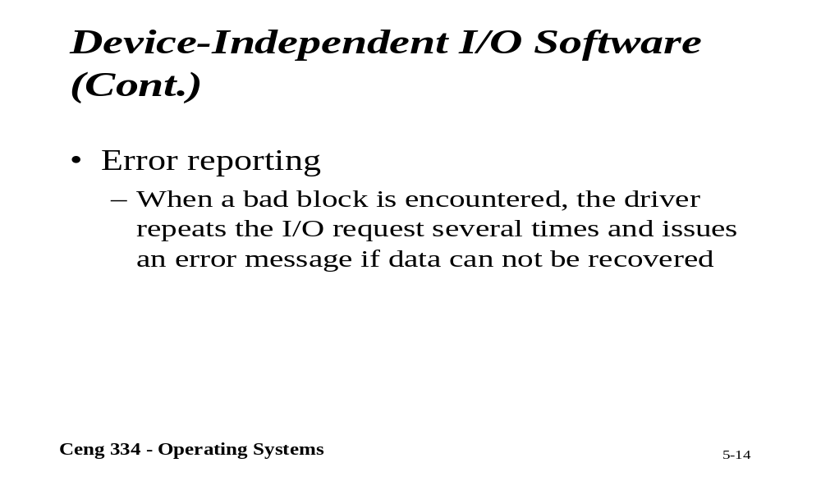
Device-Independents I/O Software

Slide 28
Device-Independent I/O Software (1)
Uniform interfacing for device drivers
Buffering
Error reporting
Allocating and releasing dedicate devices
Providing a deice-independent block size
Functions of the device-independent I/O software

Slide 29
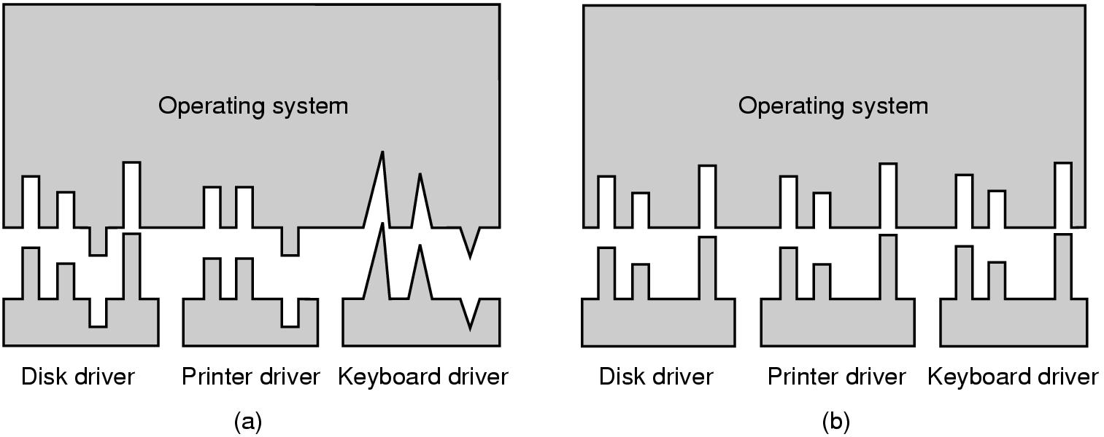
Device-Independent I/O Software (2)
(a) Without a standard driver interface
(b) With a standard driver interface

Slide 30
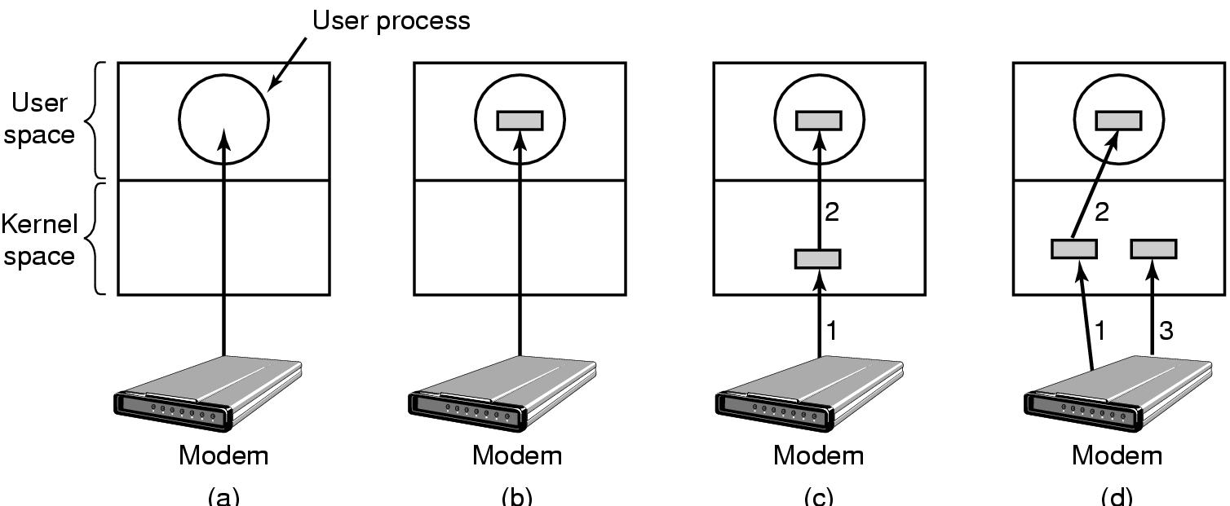
Device-Independent I/O Software (3)
(a) Unbuffered input
(b) Buffering in user space
(c) Buffering in the kernel followed by copying to user space
(d) Double buffering in the kernel

Slide 31
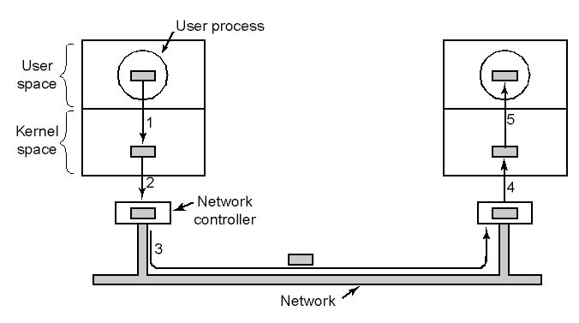
Device-Independent I/O Software (4)
Networking may involve many copies

Slide 32
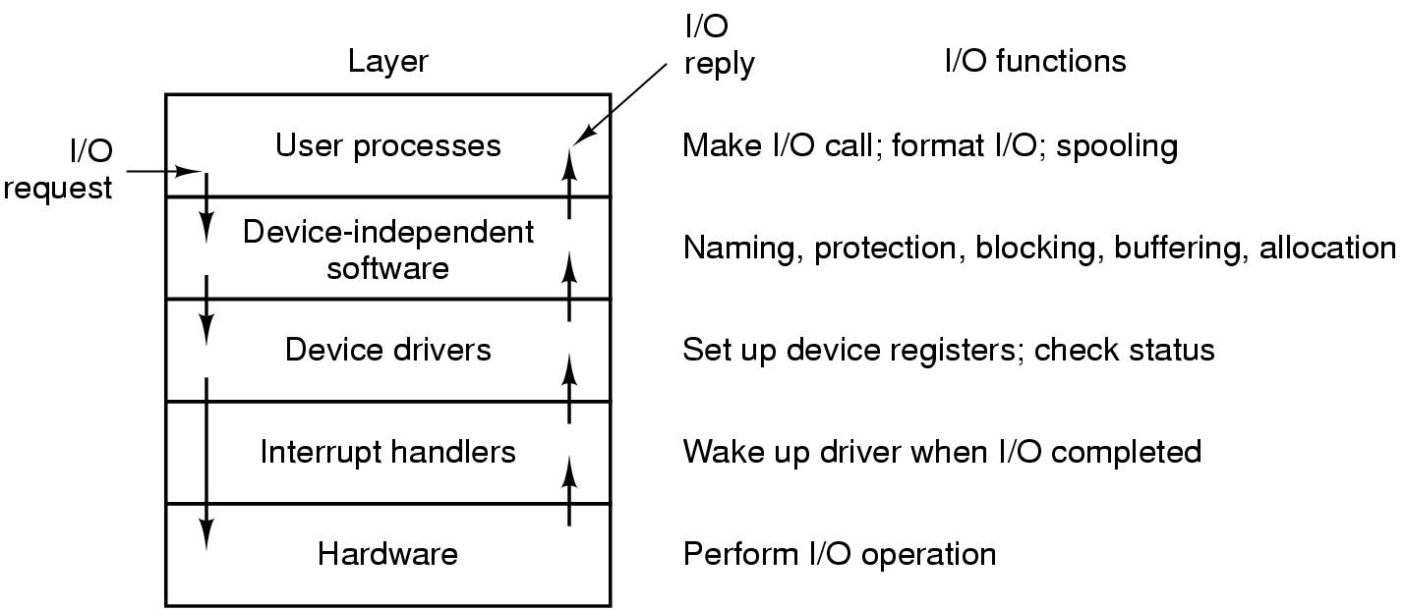
User-Space I/O Software
Layers of the I/O system and the main functions of each layer

Slide 33
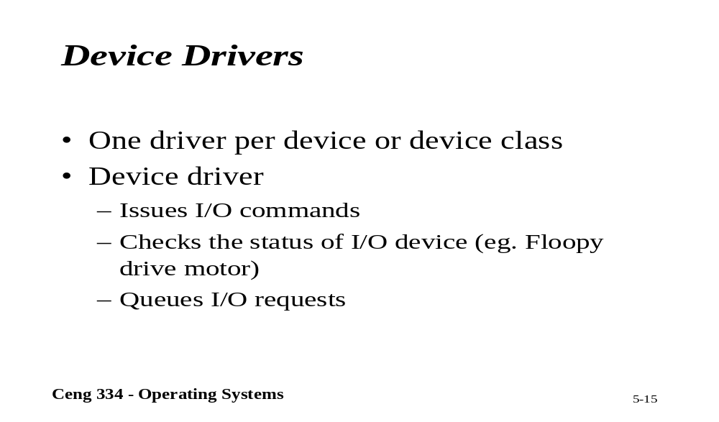
Device Drivers

Slide 34
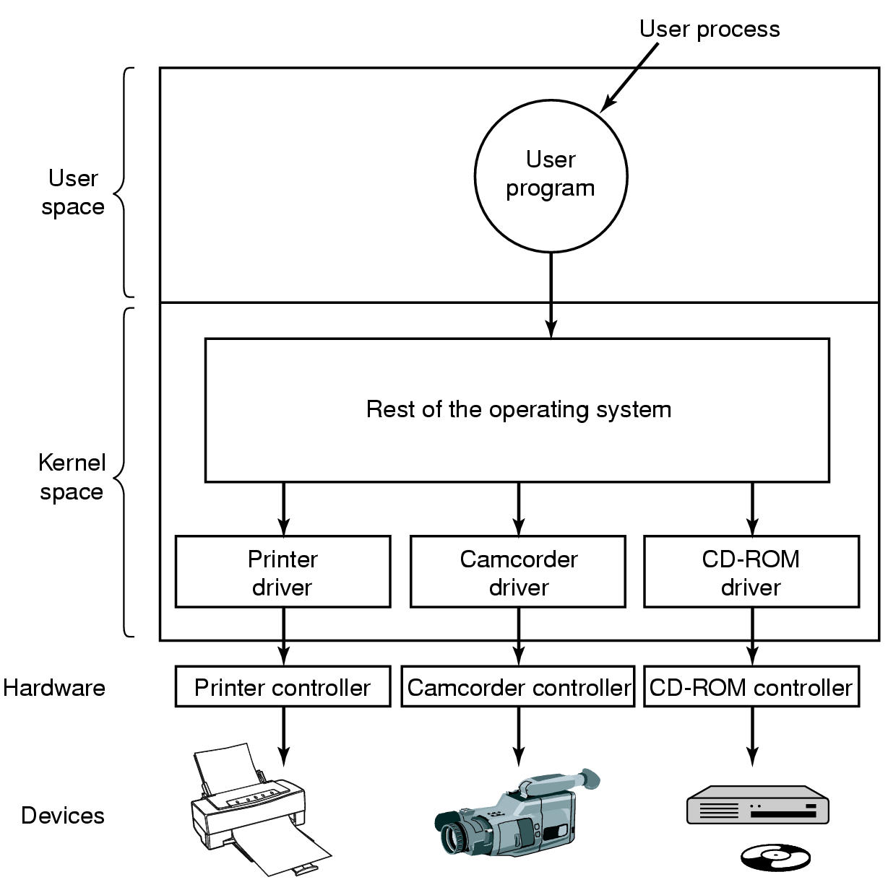
Device Drivers
Logical position of device drivers is shown here
Communications between drivers and device controllers goes over the bus

Slide 35
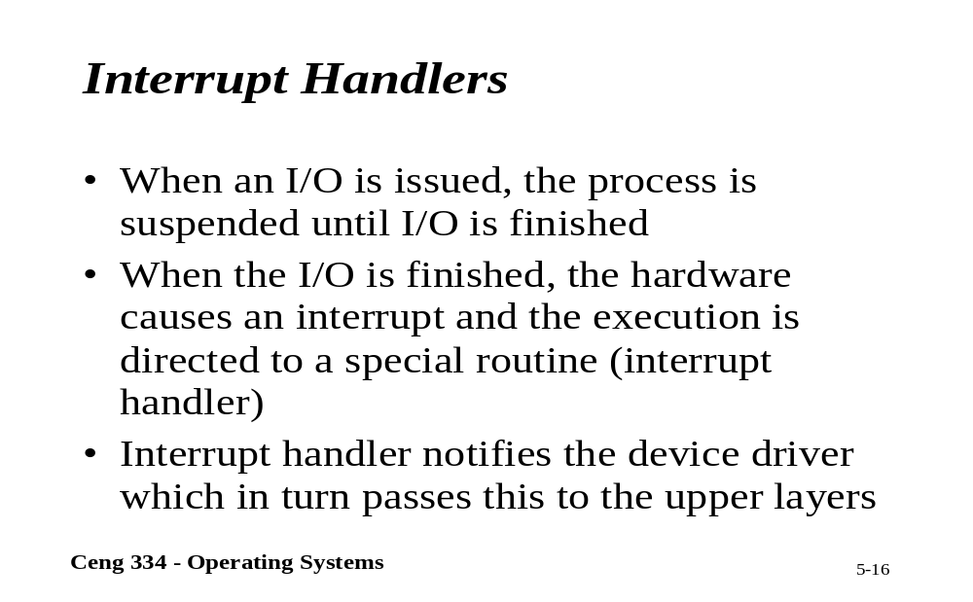
Interrupt Handlers

Slide 36
Interrupt Handlers (1)
Interrupt handlers are best hidden
  have driver starting an I/O operation block until interrupt notifies of completion
Interrupt procedure does its task
  then unblocks driver that started it
Steps must be performed in software after interrupt completed
  Save regs not already saved by interrupt hardware
  Set up context for interrupt service procedure

Slide 37
Interrupt Handlers (2)
  Set up stack for interrupt service procedure
  Ack interrupt controller, reenable interrupts
  Copy registers from where saved
  Run service procedure
  Set up MMU context for process to run next
  Load new process' registers
  Start running the new process

Slide 38
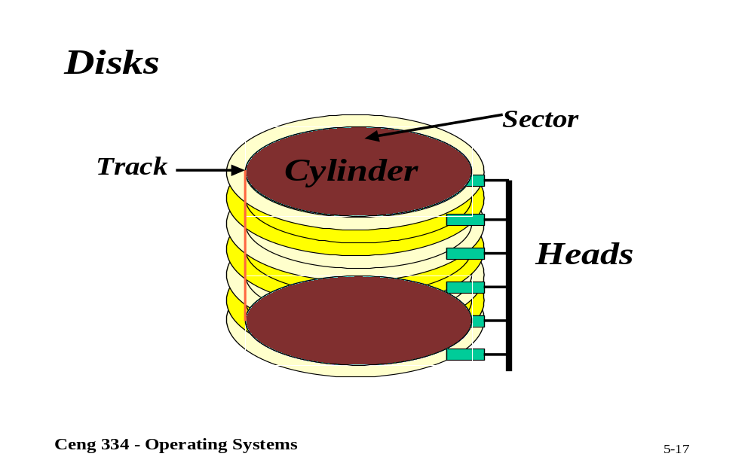
Disks

Slide 39
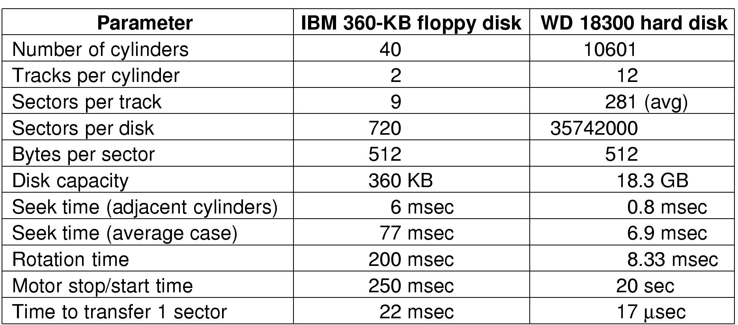
Disks
Disk Hardware (1)
Disk parameters for the original IBM PC floppy disk and a Western Digital WD 18300 hard disk

Slide 40
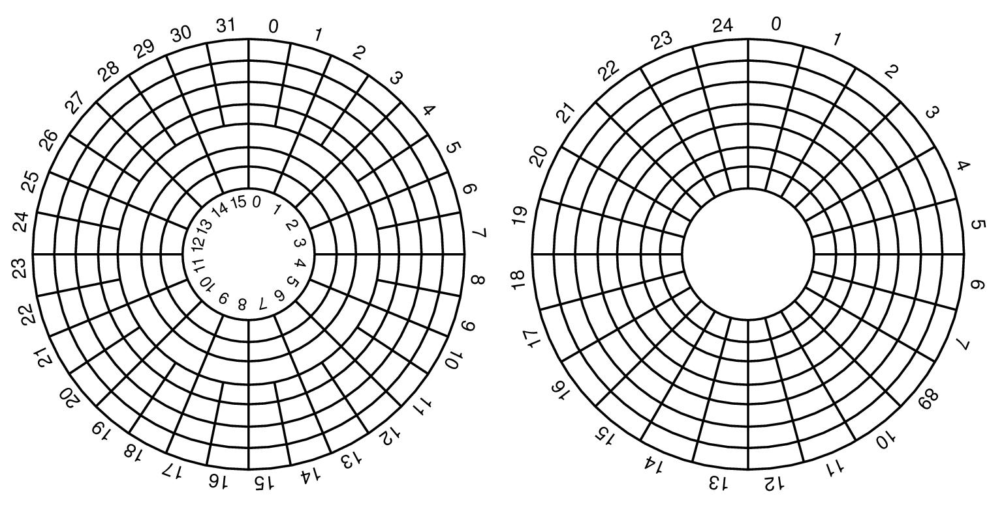
Disk Hardware (2)
Physical geometry of a disk with two zones
A possible virtual geometry for this disk

Slide 41
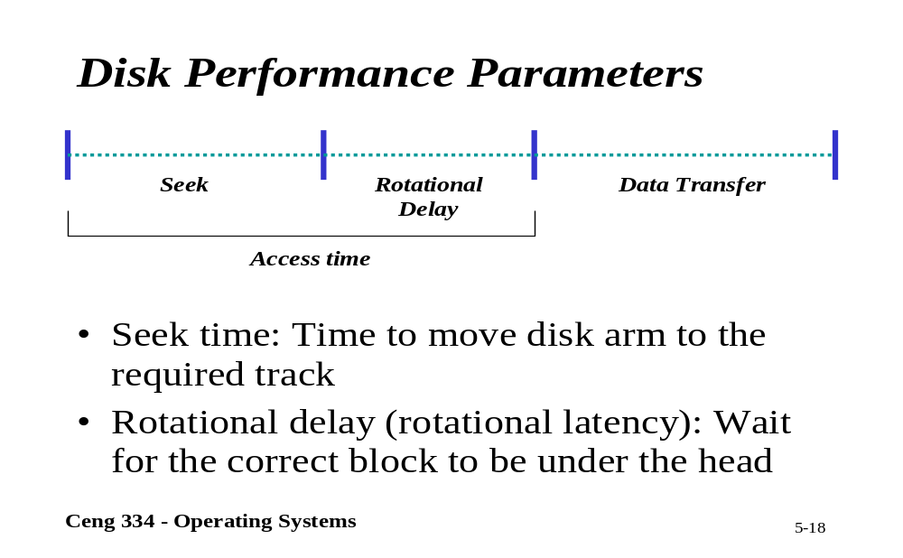
Disk Performance

Slide 42
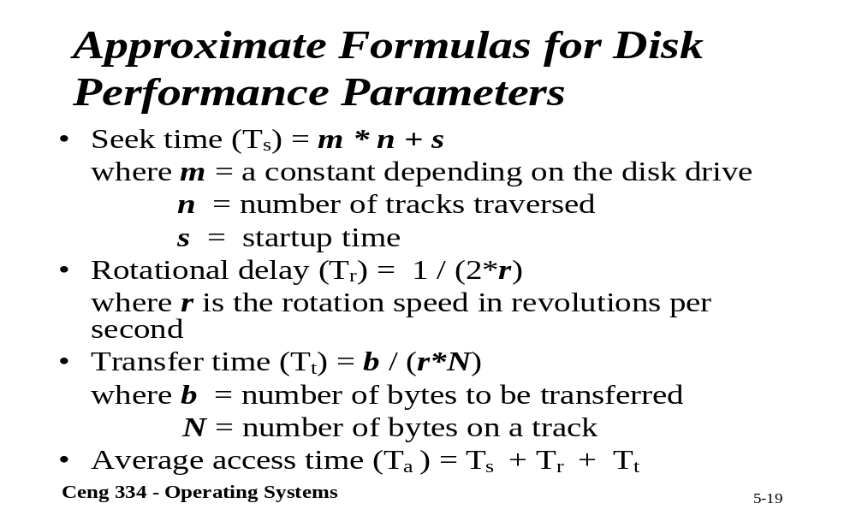
Formulas for Disk Performance

Slide 43
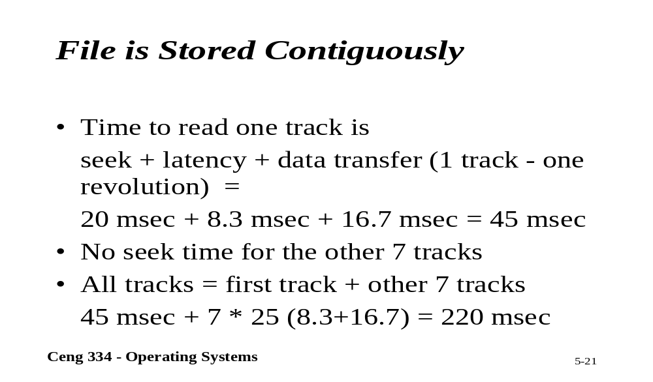
File Stored Contigiously

Slide 44
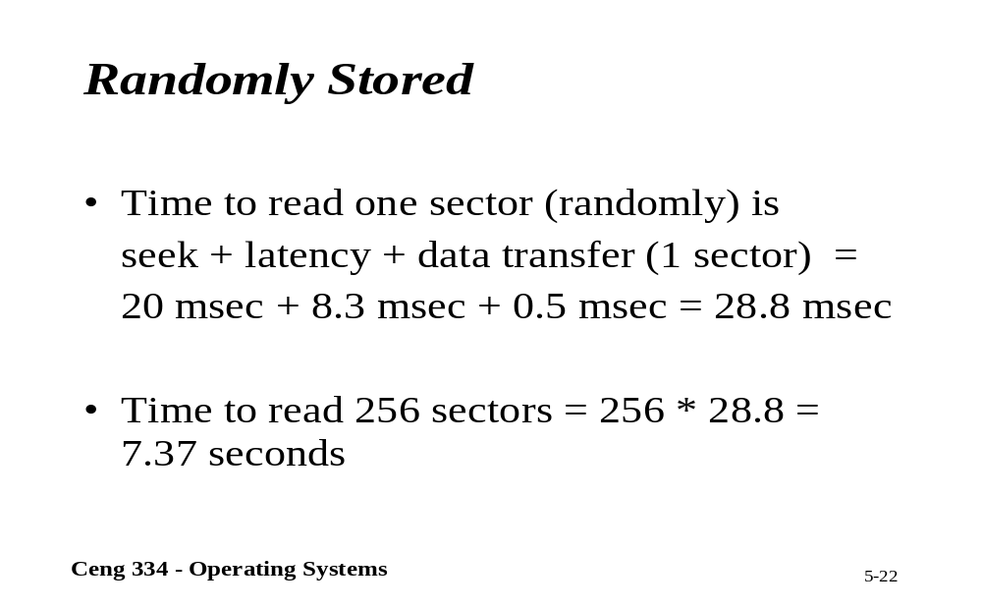
Randomly Stored Files

Slide 45
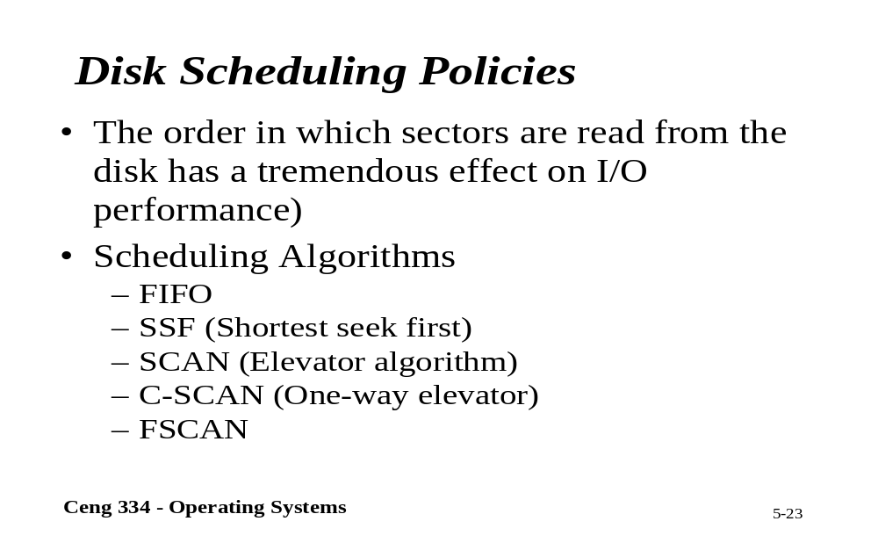
Disk Scheduling

Slide 46
Disk Arm Scheduling Algorithms (1)
Time required to read or write a disk block determined by 3 factors
  Seek time
  Rotational delay
  Actual transfer time
Seek time dominates
Error checking is done by controllers

Slide 47
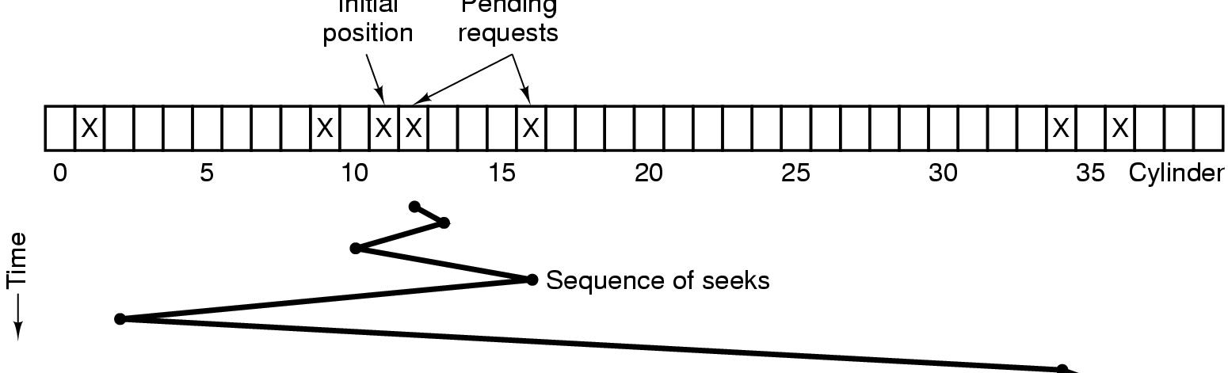
Disk Arm Scheduling Algorithms (2)
Initial
position
Pending
requests
Shortest Seek First (SSF) disk scheduling algorithm

Slide 48
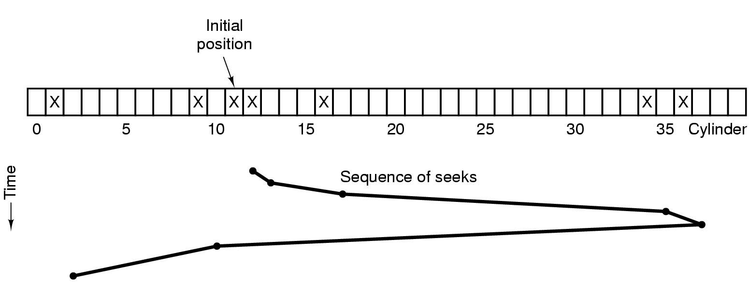
Disk Arm Scheduling Algorithms (3)
The elevator algorithm for scheduling disk requests

Slide 49
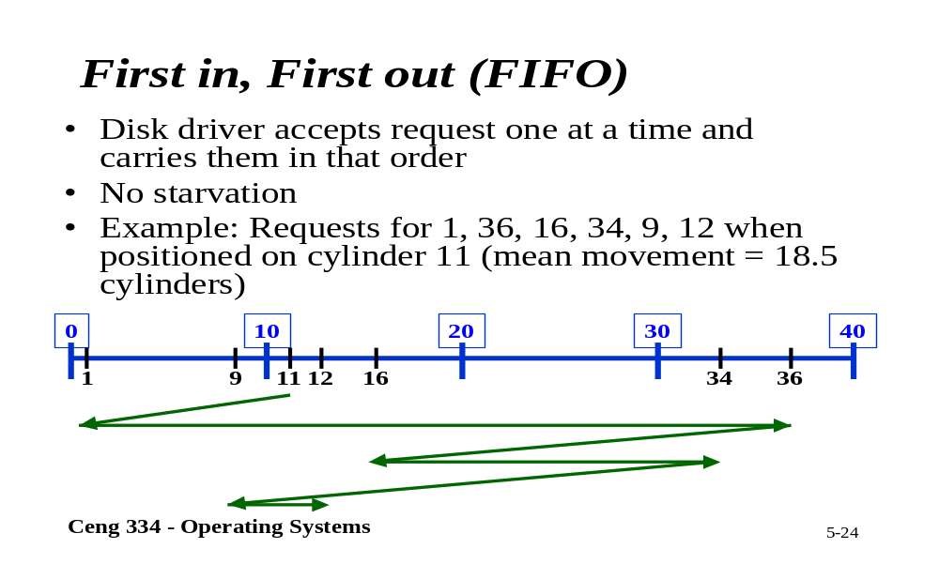
FIFO

Slide 50
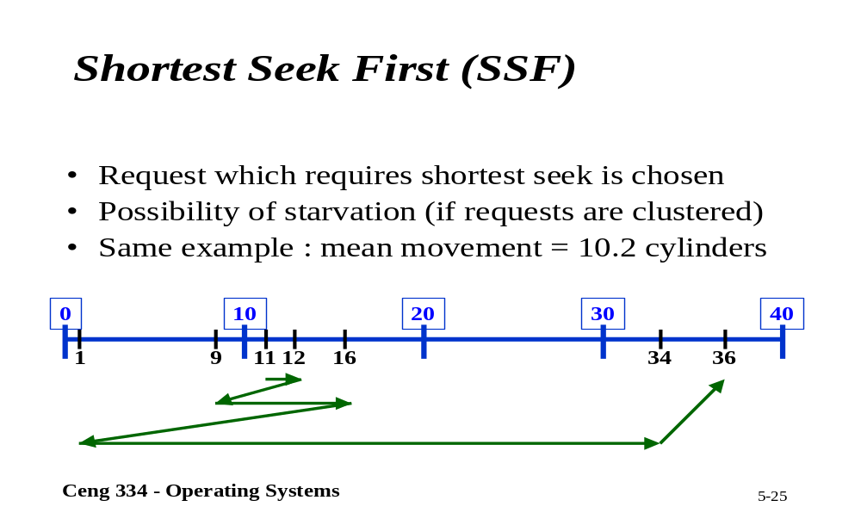
SSF

Slide 51
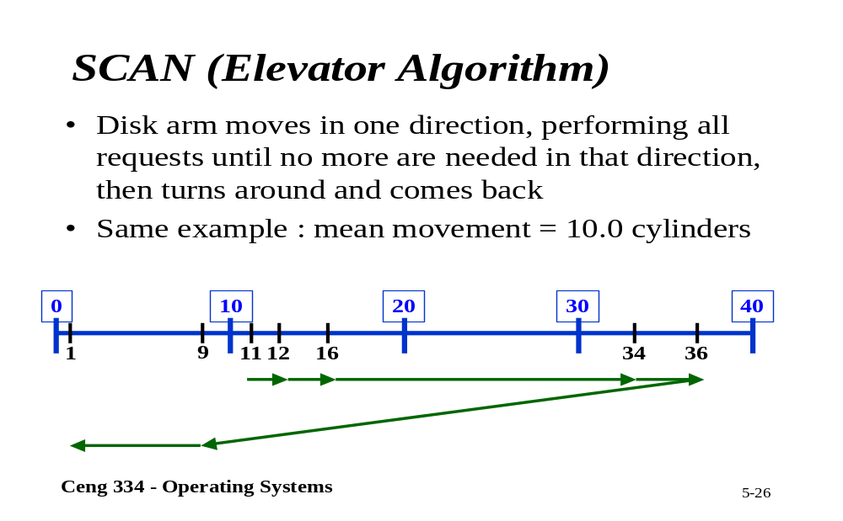
Scan

Slide 52
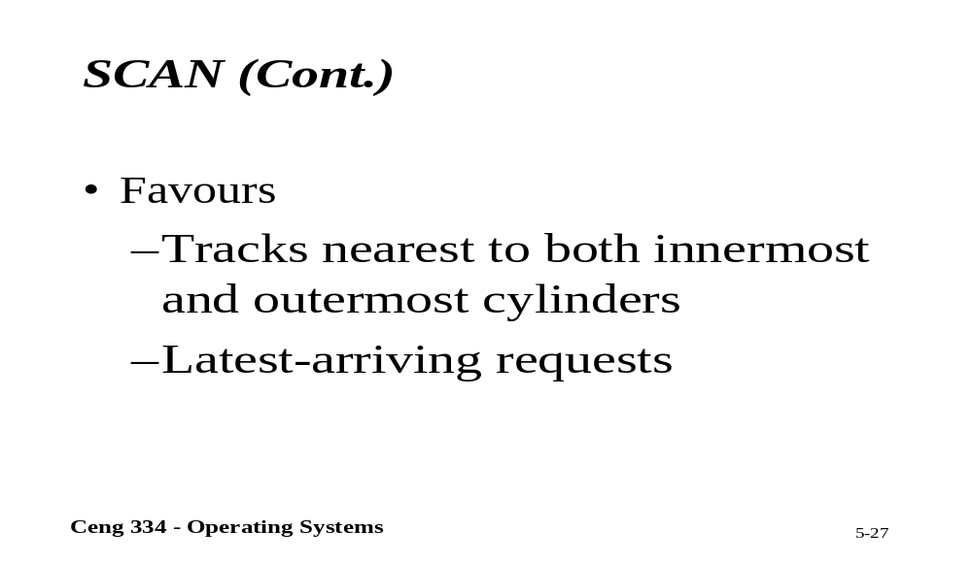
Scan

Slide 53
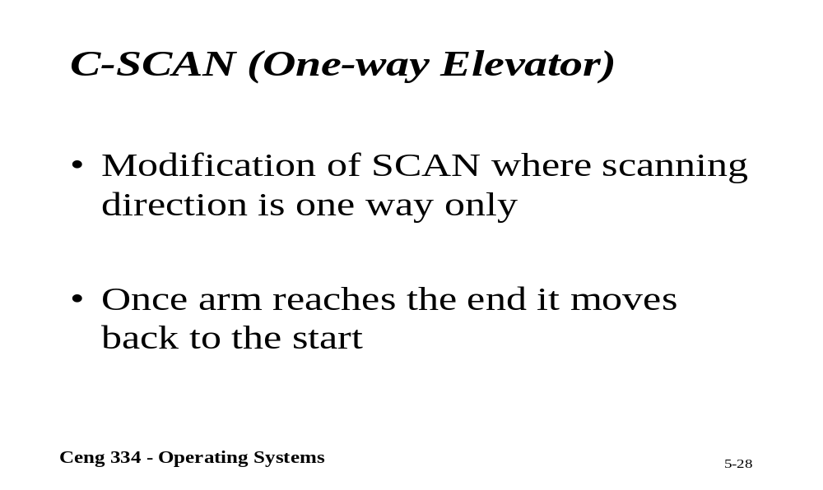
C-Scan

Slide 54
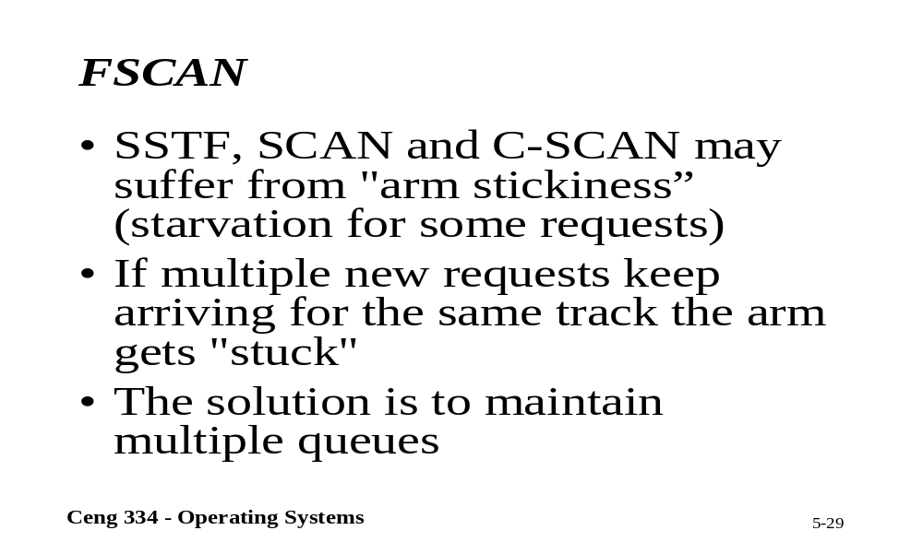
F-Scan

Slide 55
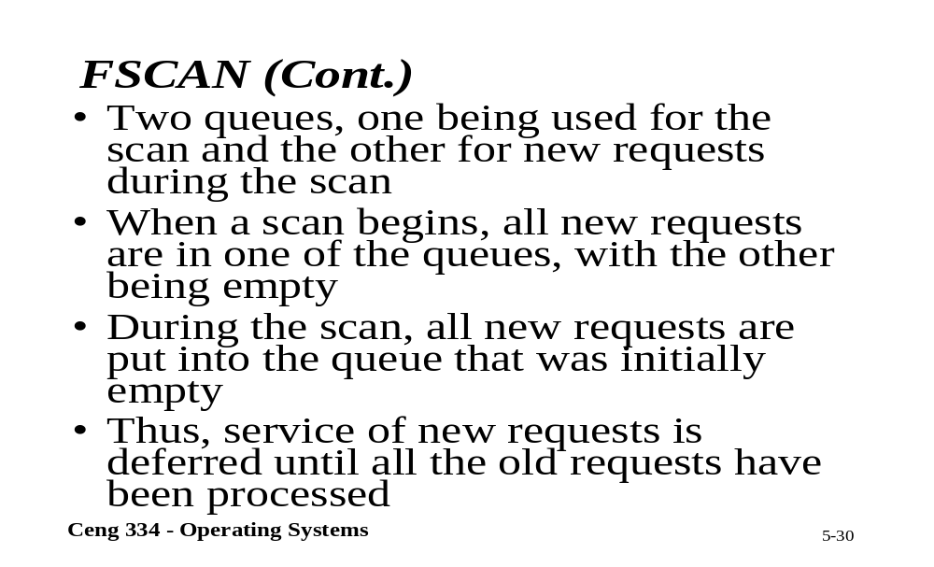
F-Scan

Slide 56
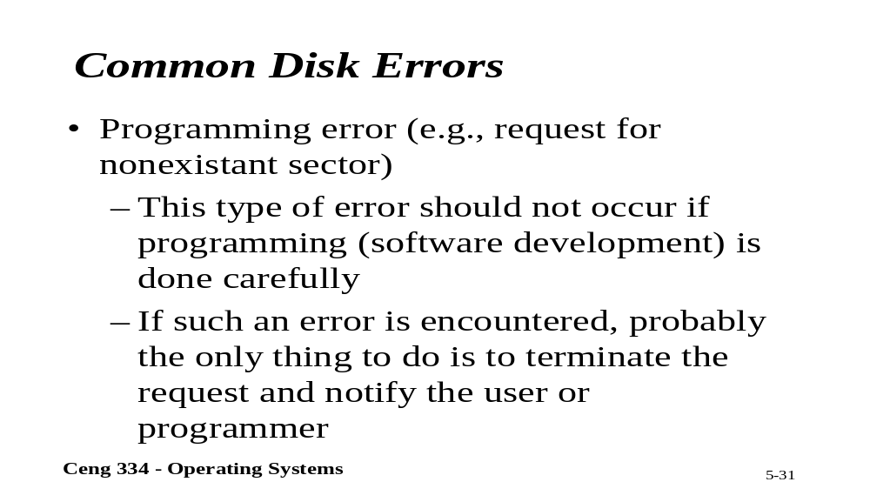
Common Disk Errors

Slide 57
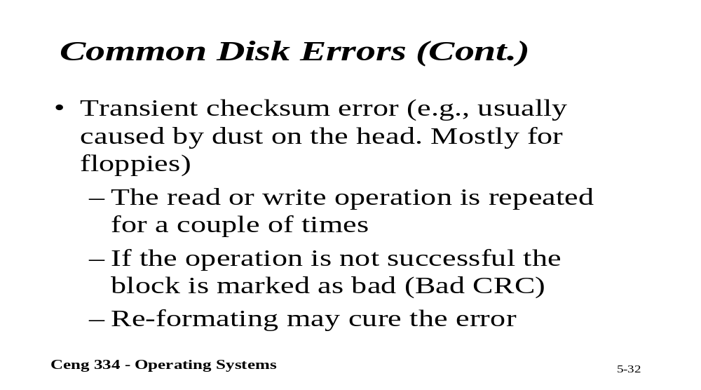
Common Disk Errors

Slide 58
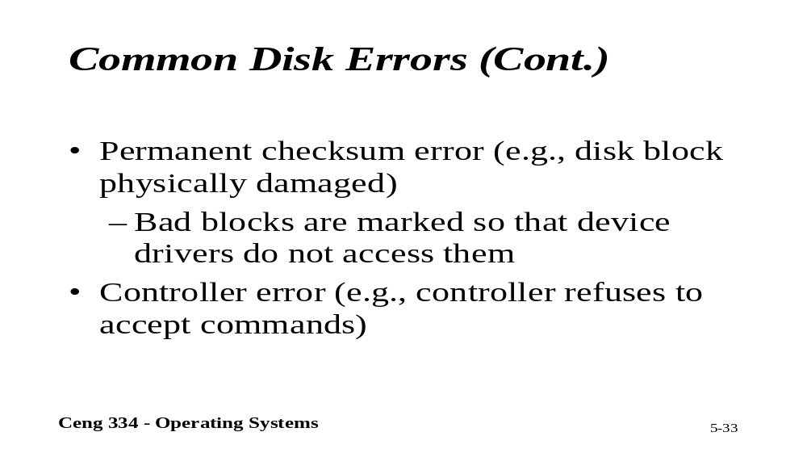
Common Disk Errors

Slide 59
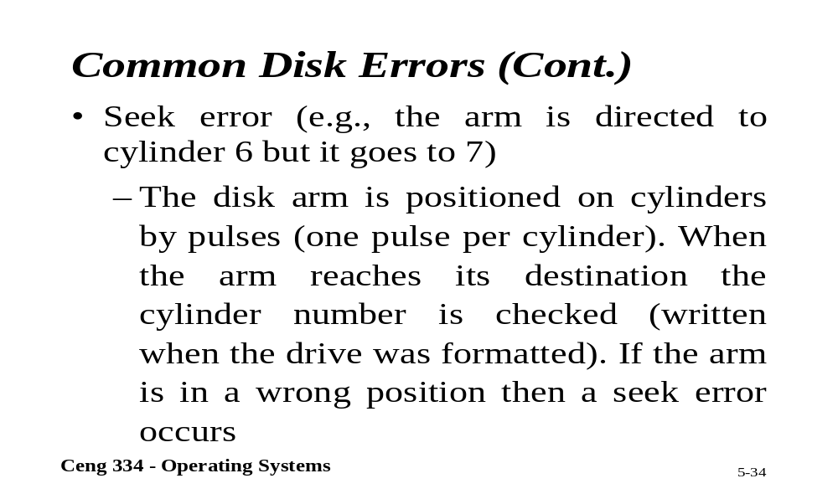
Common Disk Errors

Slide 60
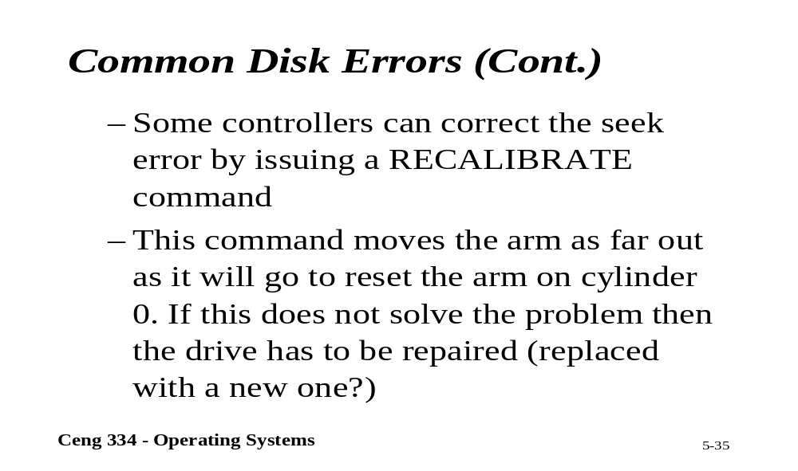
Common Disk Errors

Slide 61

RAID

Slide 62

RAID 0

Slide 63

RAID 1

Slide 64

RAID 3

Slide 65

RAID 5

Slide 66

Disk Hardware (3)
Raid levels 0 through 2
Backup and parity drives are shaded

Slide 67

Disk Hardware (4)
Raid levels 3 through 5
Backup and parity drives are shaded

Slide 68

RAID 6
RAlD 6 significantly enhances the reliability of the new Enhance RAID family

Slide 69
RAID 6 (2)
Striped set with dual distributed parity.
Provides fault tolerance from two drive failures; array continues to operate with up to two failed drives.
This makes larger RAID groups more practical, especially for high availability systems.
This becomes increasingly important because large-capacity drives lengthen the time needed to recover from the failure of a single drive.
Single parity RAID levels are vulnerable to data loss until the failed drive is rebuilt: the larger the drive, the longer the rebuild will take.
Dual parity gives time to rebuild the array without the data being at risk if a (single) additional drive fails before the rebuild is complete.

Slide 70

RAID 10
1+0 uses both sripping and mirroring

Slide 71

Disk Hardware (5)
Recording structure of a CD or CD-ROM

Slide 72
Disk Formatting (1)
A disk sector

Slide 73

Disk Formatting (2)
An illustration of cylinder skew

Slide 74

Disk Formatting (3)
No interleaving
Single interleaving
Double interleaving

Slide 75

Error Handling
A disk track with a bad sector
Substituting a spare for the bad sector
Shifting all the sectors to bypass the bad one

Slide 76

Character Oriented Terminals
RS-232 Terminal Hardware
An RS-232 terminal communicates with computer 1 bit at a time
Called a serial line – bits go out in series, 1 bit at a time
Windows uses COM1 and COM2 ports, first to serial lines
Computer and terminal are completely independent

Slide 77

Display Hardware (1)
Parallel port
Memory-mapped displays
driver writes directly into display's video RAM

Slide 78

Display Hardware (2)
A video RAM image
  simple monochrome display
  character mode
Corresponding screen
  the xs are attribute bytes

Slide 79
Input Software
Keyboard driver delivers a number
  driver converts to characters
  uses a ASCII table
Exceptions, adaptations needed for other languages
  many OS provide for loadable keymaps or code pages

Slide 80

Output Software for Windows (1)
Sample window located at (200,100) on XGA display

Slide 81

Output Software for Windows (2)
Skeleton of a Windows main program (part 1)

Slide 82
Output Software for Windows (3)
Skeleton of a Windows main program (part 2)

Slide 83

Output Software for Windows (4)
An example rectangle drawn using Rectangle

Slide 84

Output Software for Windows (5)
Copying bitmaps using BitBlt.
  before
  after

Slide 85

Output Software for Windows (6)
Examples of character outlines at different point sizes

Slide 86

Power Management (1)
Power consumption of various parts of a laptop computer

Slide 87
Power Management (4)
Telling the programs to use less energy
  may mean poorer user experience
Examples
  change from color output to black and white
  speech recognition reduces vocabulary
  less resolution or detail in an image

